Slide 1
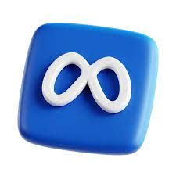
Boosting Instagram Engagement
By Rucha Patil
(Batch - May 2024)

Slide 2
Problem Statement
You are hired as a data analyst at Meta and asked to collaborate with the Marketing team. Marketing teams want to leverage Instagram's user data to develop targeted marketing strategies that will increase user engagement, retention, and acquisition. Provide insights and recommendations to address the following objectives
Identify strategies to enhance user interaction with content.
Develop methods to keep users active and engaged over time.
Encourage users to interact more by personalizing content and recommendations.
Use data insights to make marketing efforts more effective

Slide 3
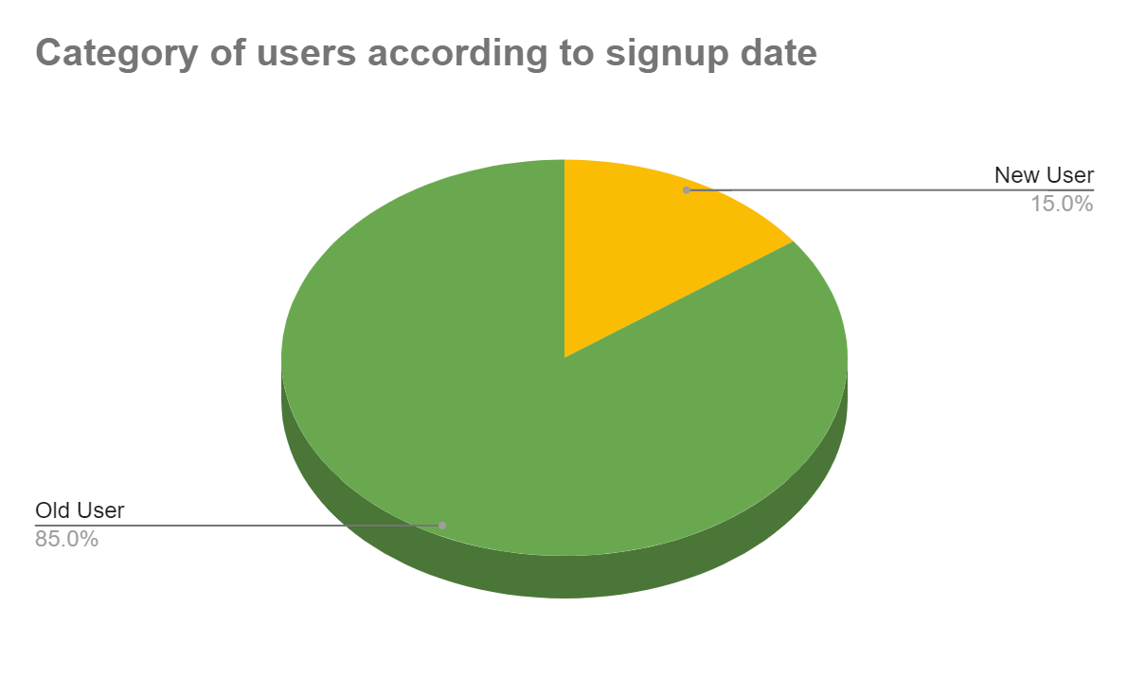
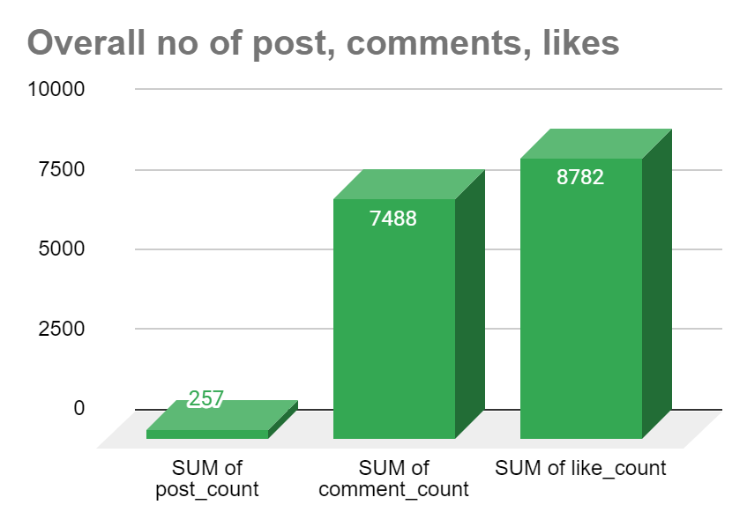
Data Overview
Total users overview: Data contains 100 users with respective posts, likes and comments.
User Engagement Metrics: Whole data includes total number of 257 posts, total number of 8782 likes, and 7488 comments.
Average number of tags per user: 1.95
Number of inactive users: 24 users found to inactive as they did not liked any post.
Data Cleaning/Preprocessing: checked for NULL values, checked for duplicates but given data did not contain any NULL and duplicated.

Slide 4

Analytical approach and tools
Descriptive Statistics: Calculated basic statistics like total number of users and respective posts posted, likes, comments achieved
Data Cleaning: Remove duplicates using the DISTINCT , TRIM keyword to ensure unique entries in the dataset.
Data Enrichment:Joined tables such as users, posts, likes, comments, followers, photo_tags, and photos to aggregate and compute key metrics, ensuring a holistic view of user activity.
Data Analysis: Used sql techniques such as Common Table Expressions (CTE), Aggregate Functions:(AVG, COUNT,ROUND, etc), Subqueries, Group By clause, Window functions.
Data Visualization: Visualized key metrics such as total posts, likes, and comments to provide a clear representation of user activity levels. Created charts and graphs to rank users based on engagement rates and to highlight the most influential hashtags.

Slide 5

Analysis of objective questions
Breakdown of the key findings based on the questions:
Data Quality: No missing or duplicate values were found in the provided data.
User Activity Distribution: Analysed it by studying number of posts, likes and comments. Analyzing user activity distribution is crucial for identifying highly active users and those with low engagement.
Average Number of Tags per Post: The average number of tags per post was calculated to be 1.95, indicating a moderate level of tagging across the posts.

Slide 6
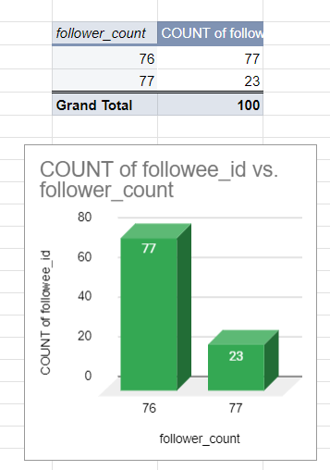
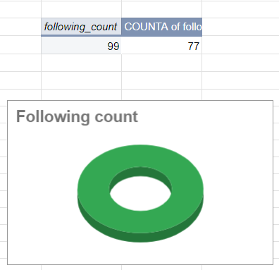
Follower Analysis:
Out of the 100 users analyzed, 23 users stood out with the highest follower count of 77 each. This indicates a select group of highly influential users who attract significant attention within the network.
Conversely, 77 users had slightly fewer followers, totaling 76 each. This dist
Following Analysis:
Interestingly, every user in the dataset has an identical following count of 99. This uniformity suggests that users are equally engaged in following others, indicating a balanced interaction within the community.

Slide 7
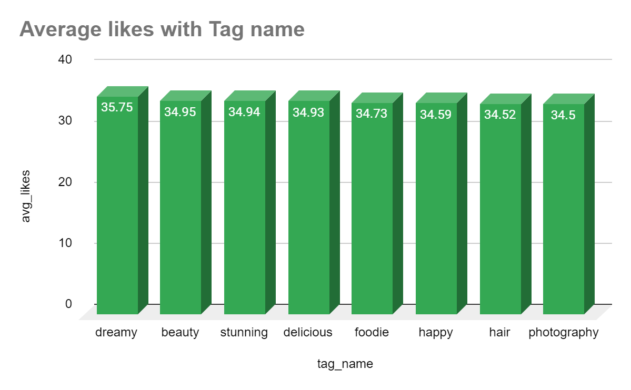
Top Hashtags by Average Likes
Inactive Users:
We found that 23 users haven't liked any posts. This group of inactive users could be a good target for special engagement efforts to get them more involved and active on the platform.
Follower Dynamics:
Our data did not show any users who began following others after being followed by them, indicating no reciprocal follow patterns in the current dataset.
#dreamy leads with an average of 35.75 likes per post.
#beauty and #stunning closely follow, with averages of 34.95 and 34.94 likes, respectively, showing strong engagement.
#delicious and #foodie are also top performers, with 34.93 and 34.73 likes on average, highlighting the appeal of food-related content.
#happy, #hair, and #photography round out the top eight, each bringing in over 34 likes per post.

Slide 8
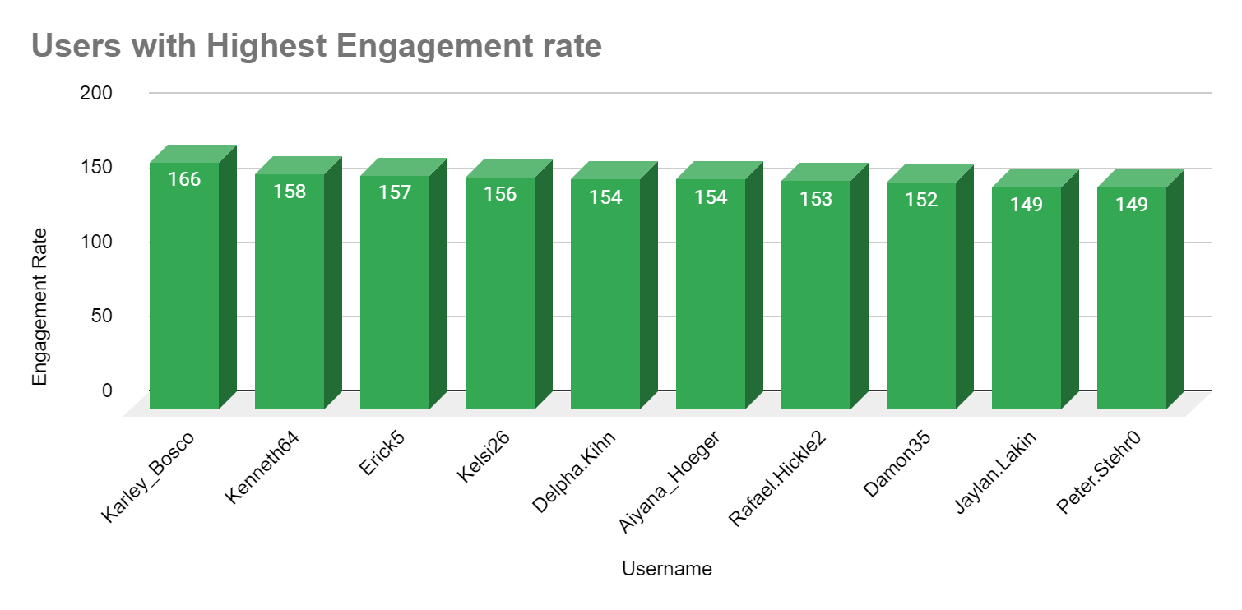
Top users with high engagement rate:
Username Karley_Bosco leads with an engagement rate of 166.
Kenneth64, Erick5, Kelsi26 ranked with 2nd, 3rd, 4th place respectively with 158, 157, 156 rate.
Delpha.Kihn and Aiyana_Hoeger both have a rate of 154.
Rafael.Hickle2 , Damon35 has a rate of 153, 152 respectively with ranking 6th, 7th.
Jaylan.Lakin and Peter.Stehr0 tie at 149.

Slide 9
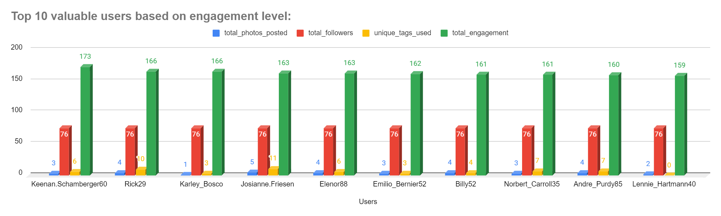
Insights from subjective questions:
Most loyal valuable users
Keenan.Schamberger60 with engagement score: 173, Rick29 with engagement score: 166, Karley_Bosco with engagement score: 166, Josianne.Friesen with engagement score: 163, Elenor88 with engagement score: 163.
These top users could be potential candidates for influencer partnerships or promotional campaigns. Their high engagement levels indicate they have a strong influence, which can be leveraged to boost brand visibility and credibility.

Slide 10
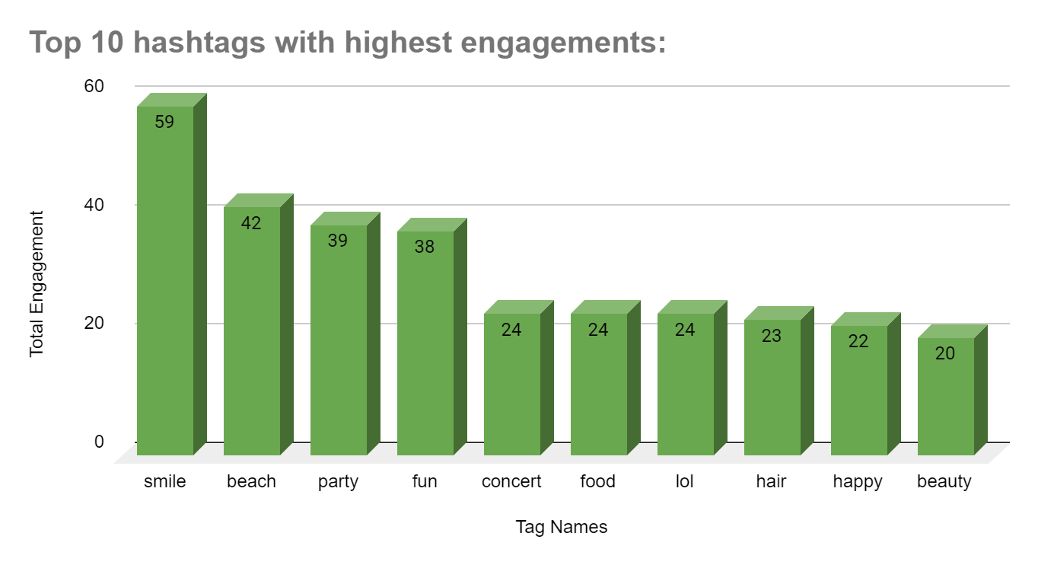
Top hashtags by engagement:
Our analysis highlights the most engaging hashtags based on total photos and engagement: #smile, #beach, #party, #fun.
These hashtags consistently attract significant interaction, showing the topics that resonate most with our audience.
By focusing on popular hashtags, we can enhance the reach and impact of our posts, making our content more engaging and relevant to the audience.

Slide 11
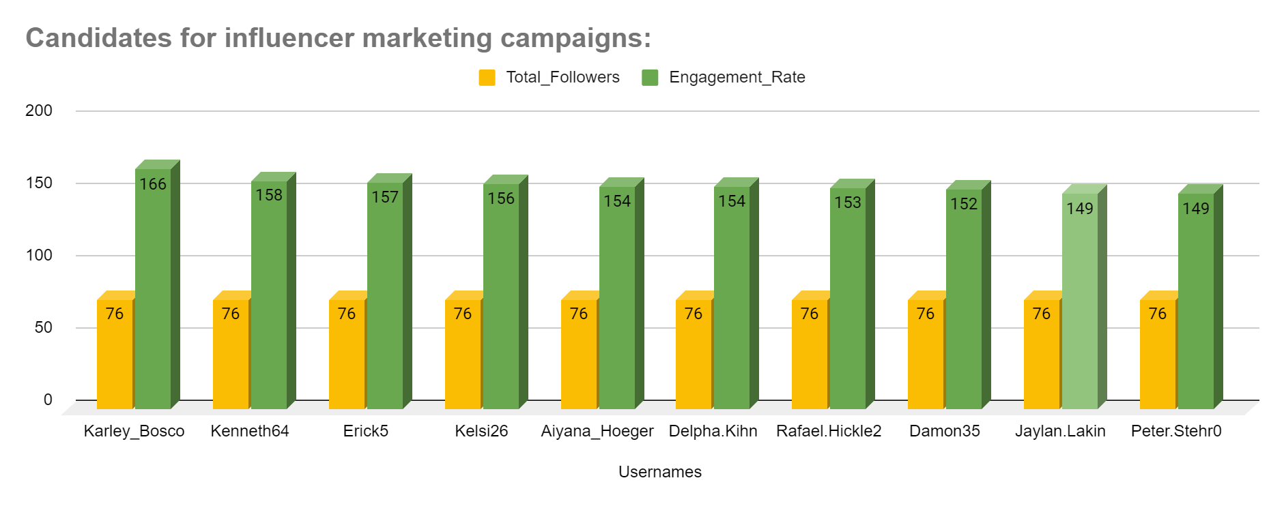
Ideal Candidates for Influencer Marketing:
We’ve pinpointed top users who are perfect for influencer marketing based on their engagement metrics: Karley_Bosco, Kenneth64, Erick5, Kelsi26, Aiyana_Hoeger
These users have high engagement rates, making them excellent candidates for influencer campaigns. Partnering with them can boost our brand’s visibility and reach by leveraging their strong connection with their audience.

Slide 12
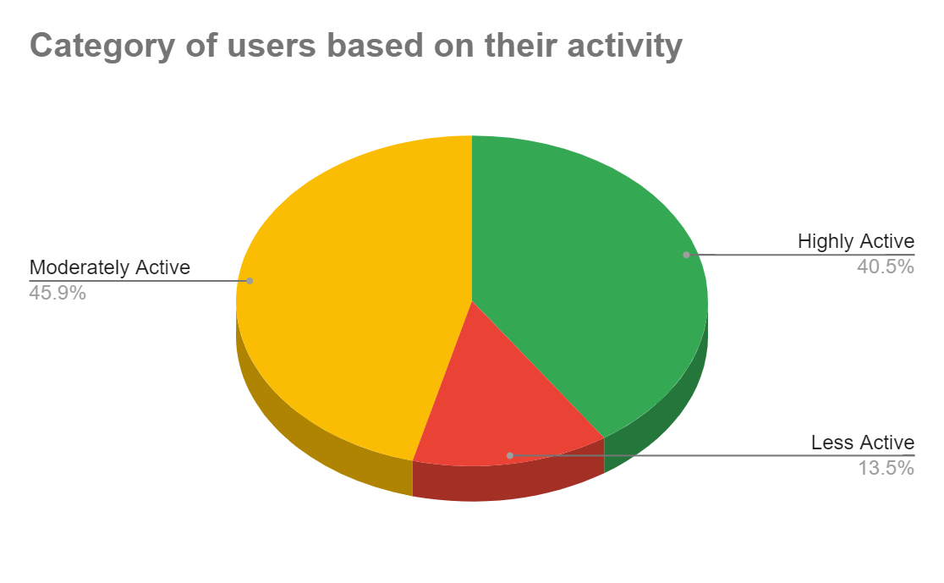
Segmentation of user base:
We’ve found that 85% of our users are old users, while 15% are new users.
For old users, we should provide personalized recommendations, loyalty rewards, and exclusive updates to keep them engaged and loyal.
For new users, offering welcome deals will help them get used to the platform and encourage them to become regular users.
We’ve found 40% of users highly active, 45% of users moderately active, and 13.5% users to be less active to our platform
This segmentation helps in tailoring targeted marketing campaigns and personalized recommendations by identifying users who are more likely to engage with content, thus enabling more focused and effective marketing strategies.

Slide 13
Strategic Recommendations
Inactive Users: Develop tailored campaigns to engage the 23 users who haven’t liked any posts. This could include personalized notifications, special offers, or exclusive content to re-engage them.
Influencer Partnerships: Collaborate with top users like Karley_Bosco, Kenneth64, and others who have high engagement rates. Their influence can amplify brand visibility and credibility through targeted influencer campaigns.
Loyal Users: Focus on high-engagement users such as Keenan.Schamberger60 and Rick29 for exclusive promotions and influencer partnerships. Their strong influence makes them ideal candidates for boosting brand awareness.

Slide 14

Popular Hashtags: Incorporate top-performing hashtags like #smile, #beach, and #party into your posts to maximize reach and engagement. These hashtags resonate well with the audience and can enhance the visibility of your content.
Tagging Practices: With an average of 1.95 tags per post, consider experimenting with different tagging strategies to see if increasing the number of tags improves engagement.
Follower and Following Analysis: Since all users follow the same number of accounts, focus on diversifying content to cater to various interests and preferences within the user base.

Slide 15
Active User Segmentation:
Highly Active Users (40%): Keep them engaged with regular updates and special content. They like frequent interaction, so continue providing it.
Moderately Active Users (45%): Create campaigns to encourage them to interact more often. Personalized suggestions and engagement strategies can help increase their activity.
Less Active Users (13.5%): Use targeted efforts to boost their engagement. This could include special offers or content that they find interesting.
New vs. Old User Strategies:
Old Users (85%): Give them personalized recommendations, loyalty rewards, and exclusive updates to keep them engaged and loyal.
New Users (15%): Offer welcome deals and introductory content to help them get used to the platform and encourage them to become regular users.

Slide 16

Conclusion
To boost user engagement and retention, I’ll tailor strategies to user activity. Highly active users will get regular updates and exclusive content. Moderately active users will receive personalized campaigns. Less active users will be targeted with special offers. Old users will benefit from loyalty rewards, while new users will receive introductory deals. These steps will enhance satisfaction and drive growth.

Slide 17


